Slide 1
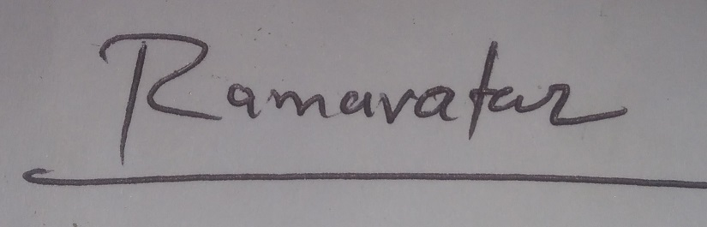
Detection of Deepfake Image
over Social Media
Name: Ramavatar Yadav Guided By:
Roll No.: 206121027 Dr. M. Sridevi

Slide 2
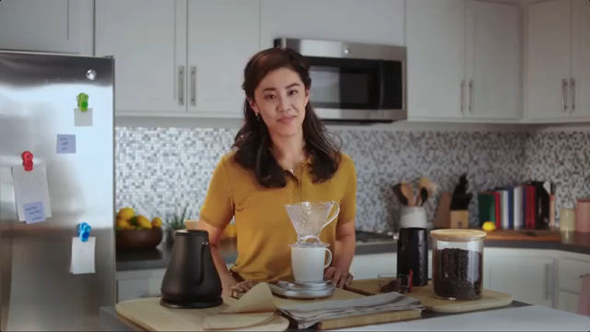
INTRODUCTION :
Deep fake is a technique for human image synthesis based on artificial intelligence.
Deep fakes are created by combing and superimposing existing images and videos onto source images or videos using a deep learning technique known as generative adversarial network.
Notes:
Deepfake is the use of AI technology to create realistic but fake videos, images, or audio recordings by manipulating or superimposing the likeness of one person onto another. It can be used for entertainment but also poses risks, such as spreading misinformation and eroding trust in media.

Slide 3
MOTIVATION/SCOPE :
Spreading of the Deep fakes over the social media platforms have become very common leading to spamming and peculating wrong information over the platform.
To overcome such a situation, Deep fake detection is very important. So, we describe a new deep learning-based method that can effectively distinguish AI generated fake videos (Deep Fake Videos) from real videos.
It’s incredibly important to develop technology that can spot fakes, so that the deep fakes can be identified and prevented from spreading over the social media.
Notes:
Detecting deepfakes helps to ensure the integrity of media and maintain the authenticity of digital content.

Slide 4
Literature Survey :
Paper & Author | Abstract summary | Pros | Cons & Scope
Deepfake Detection through Deep Learning(D. Pan, L. Sun, R. Wang, X. Zhang and R. O. Sinnott) 2020 | In this paper, it is consider the deepfake detection technologies Xception and MobileNet as two approaches for classification tasks to automatically detect deepfake videos. It is utilise training and evaluation datasets from FaceForensics++ comprising four datasets generated using four different and popular deepfake technologies. | The results show high accuracy over all datasets with an accuracy varying between 86-90% depending on the deepfake technologies applied. | It would be worth exploring the impact of different loss functions and different optimizers on the results. It would be interesting to compare model performance between a model trained with a whole face and models trained with partial facial features.
Deepfake Video Detection using Neural Networks (M. Jiwtode, A. Asati, S. Kamble and L. Damahe) 2022 | The proposed model uses features extracted from the frame level to train the RNN, which then learns to classify videos according to their temporal inconsistencies. Preparing the calculations and training the model to distinguish DF is difficult. In this model tried recognizing DF with the use of CNN and RNN. | The proposed technique can perceive the video as deepFake or genuine, given the parameters of the listed paper. It furnishes extremely high precision with real time data. | Audio isn't considered in our technique. Thus, our technique can't identify audio deepFake. Notwithstanding, propose to acknowledge audio deepFake recognition later on.
Notes:
Audio isn't considered in current system. Thus, current technique can't identify audio deepFake. Notwithstanding, the propose to acknowledge sound deepFake recognition.
Comparison of model performance between a model with a whole face and model trained with partial facial features doesn’t exist.
Rotating input images in order to find the most important direction has not been considered.

Slide 5
Paper & Author | Abstract summary | Pros | Cons & Scope
Generalization of Forgery Detection With Meta Deepfake Detection Model (V. -N. Tran, S. -G. Kwon, S. -H. Lee, H. -S. Le and K. -R. Kwon) 2023 | The goal of the model is to develop a generalized model capable of directly solving new unseen domains without the need for model updates. The MDD algorithm establishes various weights for facial images from various domains. Specifically, MDD uses meta-weight learning to shift information from the source domains to the target domains with meta-optimization steps, which aims for the model to generate effective representations of the source and target domains. It build multi-domain sets using meta splitting strategy to create a meta-train set and meta-test set. | In this paper, the propose an approach that can improve the generalization of the model, named Meta Deepfake Detection model (MDD). In this also apply block shuffling transformation to enhance the performance and reduce the overfitting problem. Moreover, there design two loss functions Pair-Attention Loss and Average-Center Alignment Loss, aggregate with softmax loss to update and learn across domains. | The Convolutional Traces CT is related to the generation process of images and further better results can be obtained by rotating input images in order to find the most important direction.
SSTNet: Detecting Manipulated Faces Through Spatial, Steganalysis and Temporal Features (X. Wu, Z. Xie, Y. Gao and Y. Xiao) 2020 | The proposed an effective and robust face manipulation detection framework by incorporating spatial, steganalysis and temporal features. Spatial features are extracted by a deep CNN and steganalysis features are extracted by a proposed novel constraint for suppressing high-level image content. Temporal features are extracted by a single LSTM. | The proposed SSTNet achieves the state-of-the-art results on the full FF++ dataset and shows good generalization on the GAN dataset. | The scope of project it will extend to build my architecture for the sole purpose of betterment of accuracy for the same cause and creating a dataset on my own.

Slide 6
Paper & Author | Abstract summary | Pros | Cons & Scope
GANprintR: Improved Fakes and Evaluation of the State of the Art in Face Manipulation Detection(J. C. Neves, R. Tolosana, R. Vera-Rodriguez, V. Lopes, H. Proença and J. Fierrez) 2020 | In this study, focus on the synthesis of entire facial images, which is a specific type of facial manipulation. The main contributions of this study are three-fold: i) a novel strategy to remove GAN “fingerprints” from synthetic fake images. an in-depth analysis of the recent literature in facial manipulation detection; iii) a complete experimental assessment of this type of facial manipulation. | In this presented a method (GANprintR) for improving the naturalness of facial fake images based on autoencoders, and we have empirically shown its ability to deceive state-of-the-art manipulation detection methods in a larger extent than some of the most sophisticate and realistic GAN-based synthetic face image generators | Having shown some of the limitations of the state of the art in face manipulation detection, in future work we can harden such face manipulation detectors by exploiting our improved fakes.
Media Forensics and DeepFakes: An Overview(L. Verdoliva) 2020 | This review paper aims to present an analysis of the methods for visual media integrity verification, that is, the detection of manipulated images and videos. Special emphasis will be placed on the emerging phenomenon of deepfakes, fake media created through deep learning tools, and on modern data-driven forensic methods to fight them. | The propose an approach that can improve the generalization of the model, named Meta Deepfake Detection model (MDD). In this model also apply block shuffling transformation to enhance the performance and reduce the overfitting problem | It is difficult to forecast whether such efforts will be able to ensure information integrity in the future, or some forms of active protection will become necessary.

Slide 7
OBJECTIVES :
To develop a system which will detecting or classify the video as deepfake or pristine using deep learning algorithm.
The system will reduce the Abuses’ and misleading of the common people over social media.

Slide 8
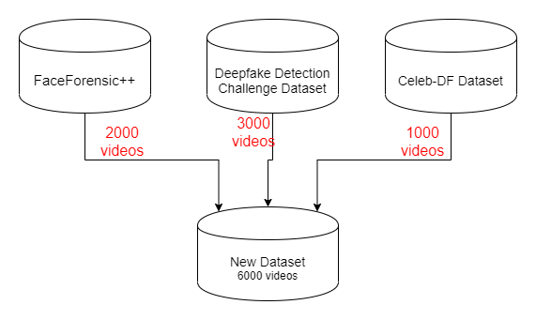
Data Collection:
Dataset | Organization | Type | Size
Celeb-DF dataset | YouTube videos | .mp4 | 4GB
Face Forensics | YouTube videos | .mp4 | 2GB
DFDC dataset | YouTube videos | .mp4 | 4GB
Notes:
I downloaded three type of dataset from youtube.

Slide 9
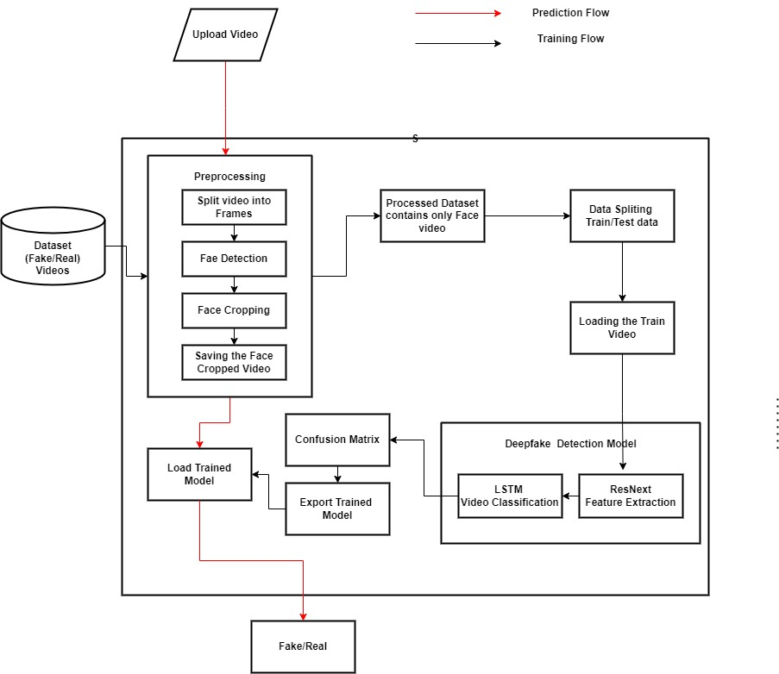

Proposed System Architecture

Slide 10
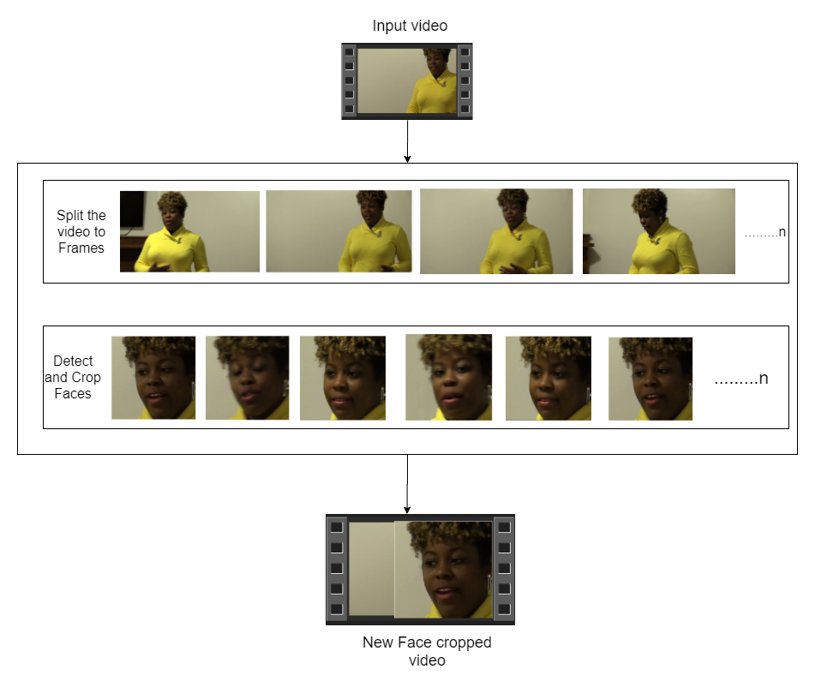

Pre-processing
SPLIT VIDEO INTO FRAMES
FACE DETECTION
5
4
3
2
1
CROPING FACE
CREATING NEW FACE CROPPED VIDEO
SAVING THE FACE CROPPED VIDEO
Notes:
In this step, the videos are preprocessed and all the unrequired and noise is removed from videos. Only the required portion of the video i.e., face is detected and cropped. The first steps in the preprocessing of the video are to split the video into frames. After splitting the video into frames, the face is detected in each of the frames and the frame is cropped along the face. Later the cropped frame is again converted to a new video by combining each frame of the video.

Slide 11
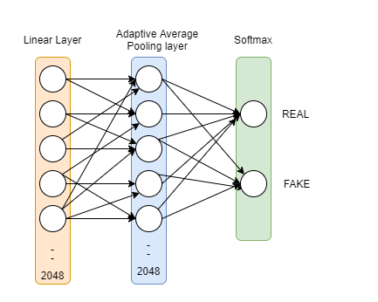
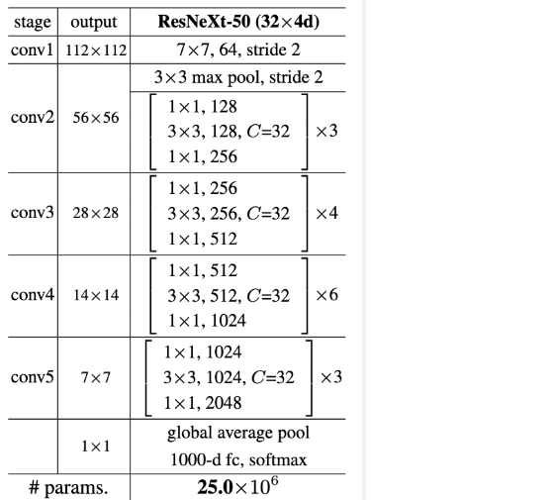

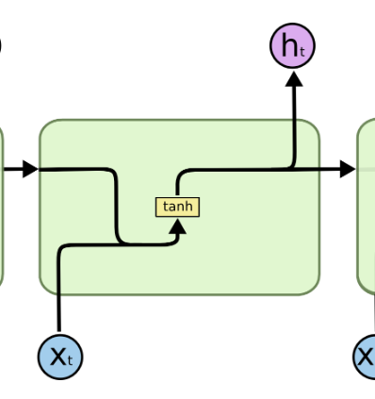
Model Architecture
ResNext-50
Sequential Layer
1 LSTM layer with 2048 shape input vector and 2048 latent features along with 0.4
chance of dropout and ReLU Activation function
Notes:
The pre-trained model of ResNext is used for feature extraction. ResNext is Residual CNN network optimized for high performance on deeper neural networks. For the experimental purpose there resnext50_32x4d model is used having 50 layers and 32 x 4 dimensions. This facilitates the sequential passing of the feature vector to the LSTM, enabling temporal analysis of the data.

Slide 12
Resnext50 Model:
ResNext-50 is a Deep Learning model for image classification of the Convolutional Neural Network
It consist of 50 layers.
F1 X H2
F2 X H2
~
Max-
Poll
F4 X H4 X W4 X D4
Avg
Poll
7*7
C
O
N
V
64
1*1
C
O
N
V
128
3*3
C
O
N
V
128
1*1
C
O
N
V
256
1*1
C
O
N
V
256
3*3
C
O
N
V
256
1*1
C
O
N
V
512
1*1
C
O
N
V
512
3*3
C
O
N
V
512
1*1
C
O
N
V
1024
1*1
C
O
N
V
1024
3*3
C
O
N
V
1024
1*1
C
O
N
V
2048
fc
1000
Image
U
X D4
X 3
X 4
X 6
X 3
Notes:
ResNeXt-50 is a convolutional neural network (CNN) model that is part of the ResNet (Residual Network) family. ResNeXt was introduced as an extension of ResNet to improve its performance on image recognition tasks.

Slide 13
Resnext50 Model:
Input layer: The first layer takes the input image and passes it on to the next layer.
Convolutional layer: A 7x7 convolutional layer with stride 2 is used to reduce the spatial dimensions of the input image.
Batch normalization and activation: A batch normalization layer is applied followed by a ReLU activation.
Max pooling: A max pooling layer with a 3x3 kernel and stride 2 is applied to further reduce the spatial dimensions.
Residual blocks: The core of the ResNeXt50 model consists of a stack of 4 residual blocks. Each block has a similar structure.
Global average pooling: The output of the last residual block is fed into a global average pooling layer, which averages the feature maps across the spatial dimensions.
Fully connected layer: The global average pooled features are passed through a fully connected layer with 1000 output units, one for each class in the ImageNet dataset.
Softmax activation: A softmax activation function is applied to the output of the fully connected layer to generate the final class probabilities.

Slide 14
LSTM Model:
Input layer: The first layer takes the input data and passes it on to the next layer. The input can be a sequence of values.
LSTM layer: This is the core layer of the LSTM model, where the sequence of inputs is processed. It has multiple LSTM cells that process each input in the sequence and maintain a state variable that captures the long-term dependencies between inputs.
LSTM is employed to process the video frames in a sequential manner, allowing for the identification of temporal changes. The 2048-dimensional feature vectors are utilized as input to the LSTM. Our model includes one LSTM layer with 2048 latent dimensions and 2048 hidden layers.
Additionally, a dropout rate of 0.4 is applied to enhance the model's performance. By sequentially analyzing the frames, LSTM enables us to assess temporal variations in the video. This involves comparing the frame at time 't' with the frame 't-n', where 'n' can represent any number of frames preceding 't'.
For sequential processing of the frames a Sequential Layer is used. The batch size of 4 is used to perform batch training. A SoftMax layer is used to get the confidence of the model during prediction.

Slide 15
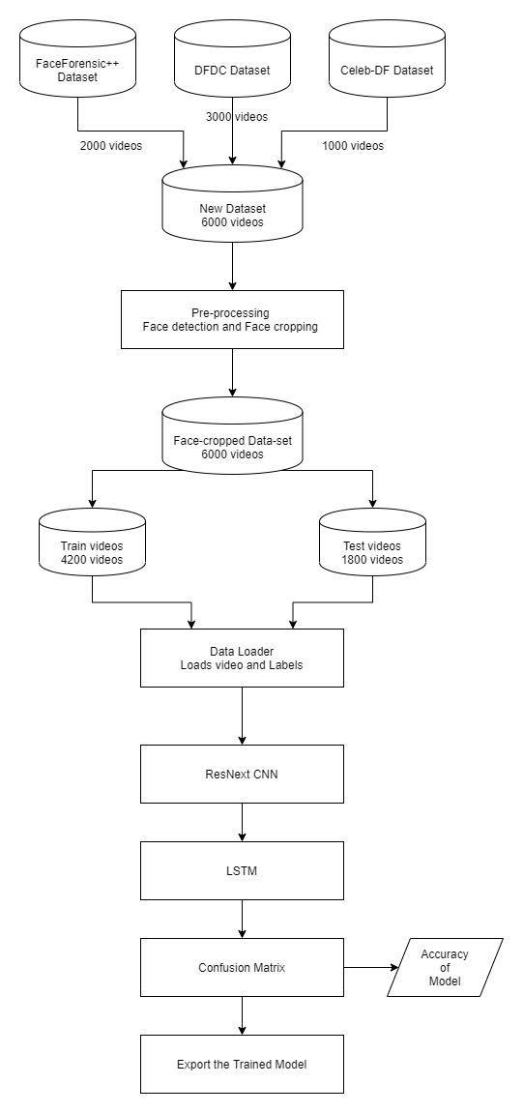
Training Workflow

Slide 16
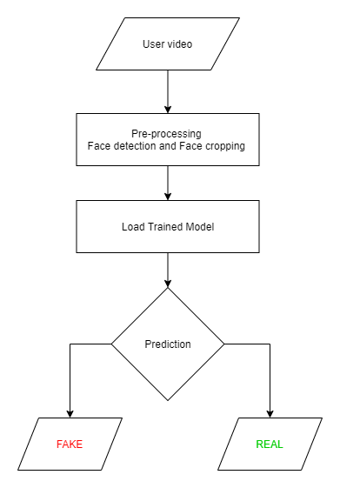
Prediction Workflow

Slide 17
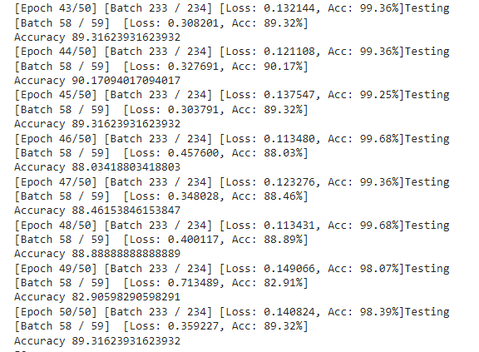
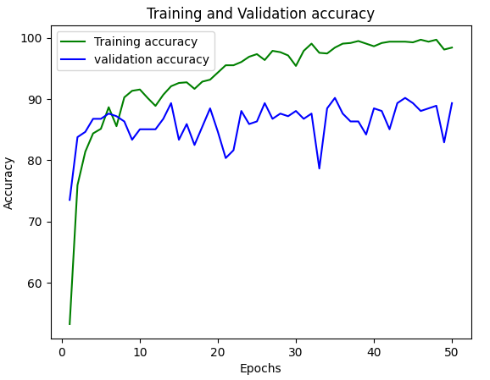
RESULTS AND ANALYSIS
Training and Validation Accuracy :
Model 1 (ResNext50):
Fig: Accuracy v/s Num of epochs Curve
Fig: Accuracy Score

Slide 18
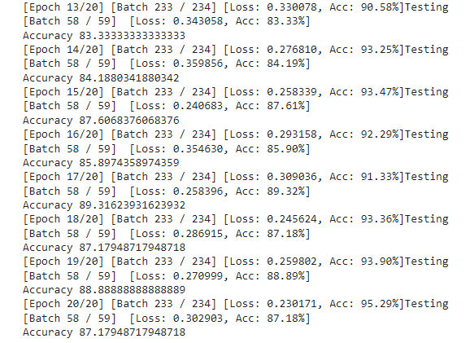
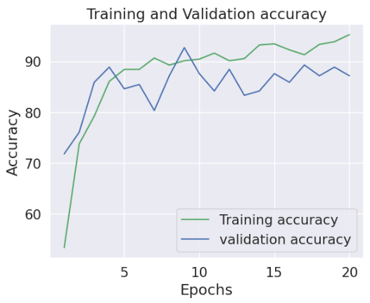
Training and Validation Accuracy :
Model 2 (Inception_v3):
Fig: Accuracy v/s Num of epochs Curve
Fig: Accuracy Score

Slide 19
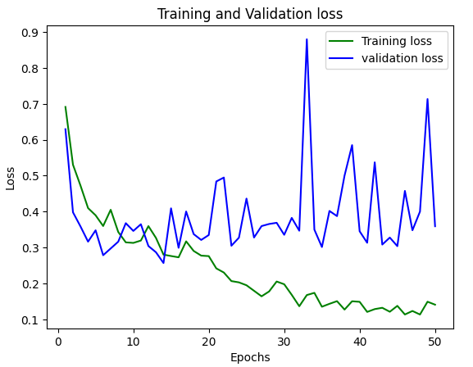
Training and Validation Loss :
Model 1 (ResNext50):
Fig: Loss v/s Num of epochs Curve
Fig: Accuracy Score

Slide 20
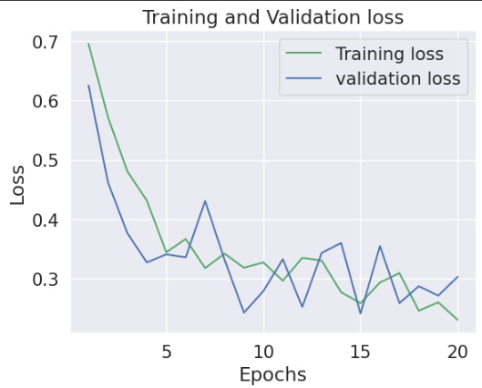
Training and Validation Loss :
Model 2 (Inception_v3):
Fig: Loss v/s Num of epochs Curve
Fig: Accuracy Score

Slide 21
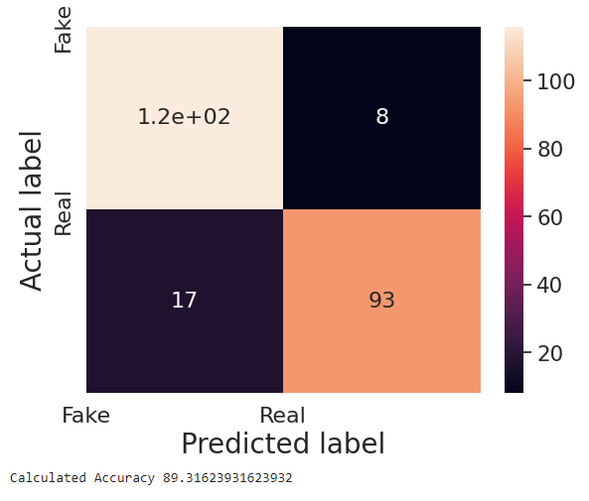
Confusion Matrix :
Model 1 (ResNext50):
Precision : 0.93
Recall : 0.87
F1 Score : 0.90
Calculated Accuracy : 89%
Notes:
Accuracy= $\frac{TP+TN}{TP+TN+FP+FN}$
Precision = $\frac{TP}{TP+FP}$
Recall = $\frac{TP}{TP+FN}$
F1-score = $\frac{2 × Precision × Recall}{Precision + Recall }$

Slide 22
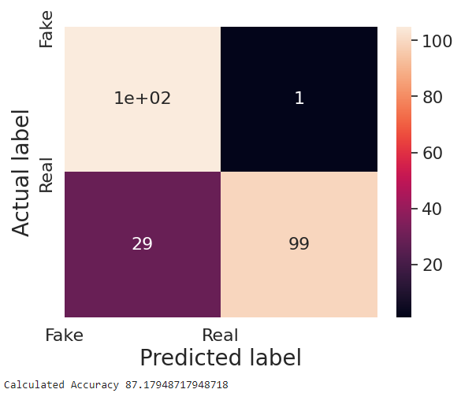
Confusion Matrix :
Model 2 (Inception_v3):
Precision : 0.99
Recall : 0.78
F1 Score : 0.87
Calculated Accuracy : 87%
Notes:
Accuracy= $\frac{TP+TN}{TP+TN+FP+FN}$
Precision = $\frac{TP}{TP+FP}$
Recall = $\frac{TP}{TP+FN}$
F1-score = $\frac{2 × Precision × Recall}{Precision + Recall }$

Slide 23
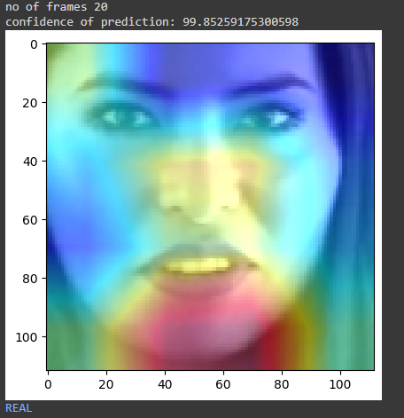
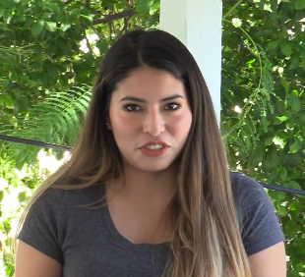
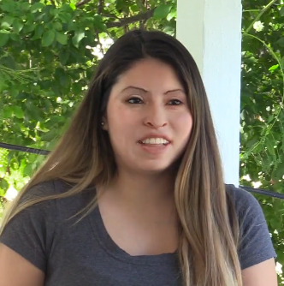
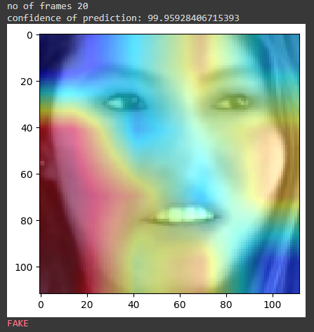
Prediction:
Confidence of
prediction : 99%
Result: REAL
Fig. : Original video Frame
Fig. : predict as REAL video
Confidence of
prediction : 99%
Result: FAKE
Fig. : Deepfake video Frame
Fig. : predict as FAKE video
Notes:
A neural network-based approach to classify the video as deep fake or real, along with the confidence of proposed model is presented. Our method can predict the output by processing 1 second of video (10 frames per second) with a good accuracy. The model is implemented by using pre-trained ResNext CNN model to extract the frame level features and LSTM for temporal sequence processing to spot the changes between the t and t-1 frame.

Slide 24
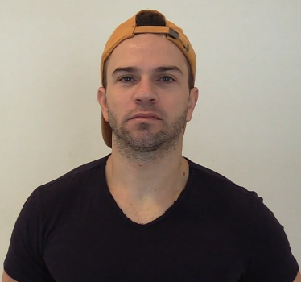
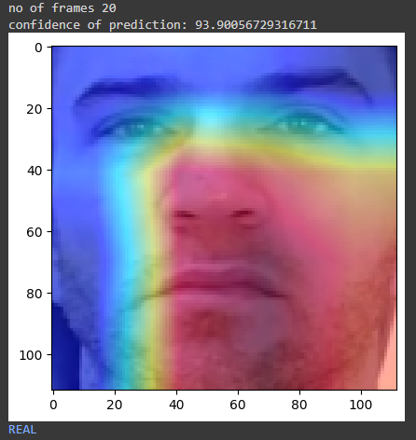
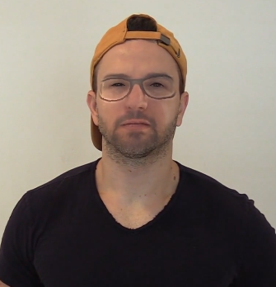
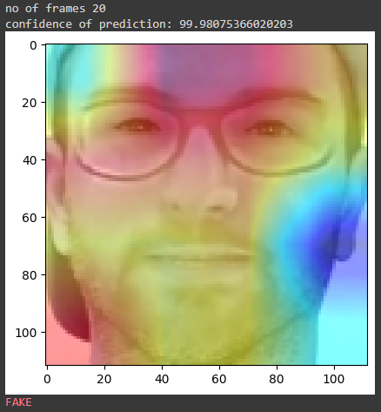
Prediction:
Confidence of
prediction : 93%
Result: REAL
Fig. : Original video Frame
Fig. : predict as REAL video
Confidence of
prediction : 99%
Result: FAKE
Fig. : Deepfake video Frame
Fig. : predict as FAKE video

Slide 25
References:
[1] V. -N. Tran, S. -G. Kwon, S. -H. Lee, H. -S. Le and K. -R. Kwon, "Generalization of Forgery Detection With Meta Deepfake Detection Model," in IEEE Access, vol. 11, pp. 535-546, 2023, doi: 10.1109/ACCESS.2022.3232290.
[2] M. Jiwtode, A. Asati, S. Kamble and L. Damahe, "Deepfake Video Detection using Neural Networks," 2022 IEEE International Conference on Blockchain and Distributed Systems Security (ICBDS), Pune, India, 2022, pp. 1-5, doi: 10.1109/ICBDS53701.2022.9935984.
[3] L. Guarnera, O. Giudice and S. Battiato, "Fighting Deepfake by Exposing the Convolutional Traces on Images," in IEEE Access, vol. 8, pp. 165085-165098, 2020, doi: 10.1109/ACCESS.2020.3023037.
[4] J. C. Neves, R. Tolosana, R. Vera-Rodriguez, V. Lopes, H. Proença and J. Fierrez, "GANprintR: Improved Fakes and Evaluation of the State of the Art in Face Manipulation Detection," in IEEE Journal of Selected Topics in Signal Processing, vol. 14, no. 5, pp. 1038-1048, Aug. 2020, doi: 10.1109/JSTSP.2020.3007250.
[5] D. Pan, L. Sun, R. Wang, X. Zhang and R. O. Sinnott, "Deepfake Detection through Deep Learning," 2020 IEEE/ACM International Conference on Big Data Computing, Applications and Technologies (BDCAT), Leicester, UK, 2020, pp. 134-143, doi: 10.1109/BDCAT50828.2020.00001.
[6] X. Wu, Z. Xie, Y. Gao and Y. Xiao, "SSTNet: Detecting Manipulated Faces Through Spatial, Steganalysis and Temporal Features," ICASSP 2020 - 2020 IEEE International Conference on Acoustics, Speech and Signal Processing (ICASSP), Barcelona, Spain, 2020, pp. 2952-2956, doi: 10.1109/ICASSP40776.2020.9053969.

Slide 26
References:
[7] Deepfake detection challenge dataset : https://www.kaggle.com/c/deepfake-detection- challenge.
[8] Andreas Rossler, Davide Cozzolino, Luisa Verdoliva, Christian Riess, Justus Thies, Matthias Nießner, “FaceForensics++: Learning to Detect Manipulated Facial Images” in arXiv:1901.08971
[9] Yuezun Li, Siwei Lyu, “ExposingDF Videos By Detecting Face Warping Arti- facts,” in arXiv:1811.00656v3.
[10] Yuezun Li, Ming-Ching Chang and Siwei Lyu “Exposing AI Created Fake Videos by Detecting Eye Blinking” in arXiv:1806.02877v2.
[11] Huy H. Nguyen , Junichi Yamagishi, and Isao Echizen “ Using capsule net- works to detect forged images and videos ” in arXiv:1810.11215.
[12] ResNext Model : https://pytorch.org/hub/pytorch_vision_resnext/ accessed on 06 April 2020.
[13] TensorFlow: https://www.tensorflow.org/ .
[14] Keras : https://keras.io/ .
[15] PyTorch : https://pytorch.org/ .

Slide 27
Thank You!

